Slide 1
New Disclosures Process
Consumer Direct

Slide 2
New Disclosure Process
Loan Officers will now be able to get Disclosures out to the borrower in a quicker and more efficient manner
This will allow the borrower to sign their initial disclosures and go over the initial details of the loan with the loan officer before submission.
This allows the loan officer to address any concerns the borrower has before the file gets sent over to a processor and get confirmation that the borrower is onboard with the terms of the loan by signing
This will speed up the process of the loan because the file has been sold upfront and agreed upon by the time it reaches the processor so they can order all the necessary items without delay

Slide 3
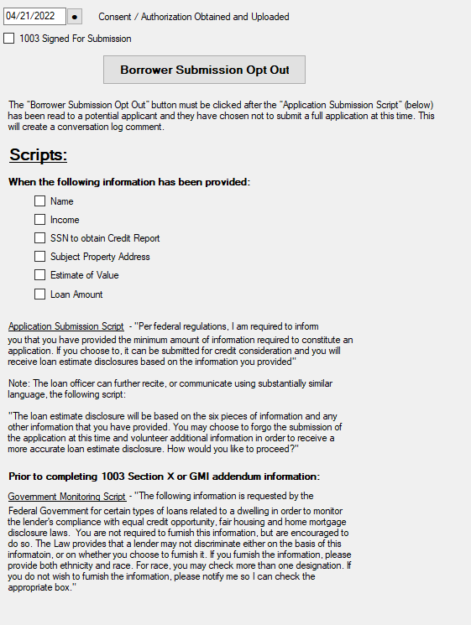
What is Required
The loan officer will be required to make sure that the necessary information is in the loan application before the file can be disclosed. These items will be checked off in the Retail Lead Processing screen in BytePro
These pieces of information are:
Interest Rate
Name
Income
SSN to obtain Credit Report
Subject Property Address
Estimate of Value
Loan Amount
Signed 1003

Slide 4
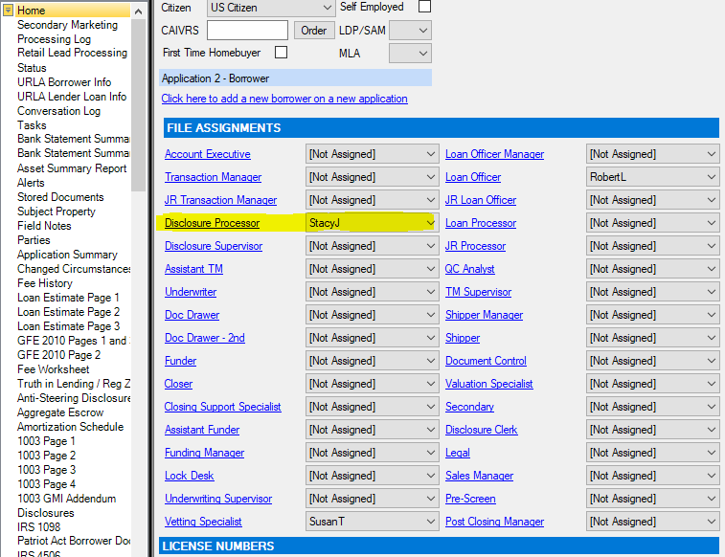
What is Required Continued
In the home tab of BytePro the Loan officer will put “StacyJ” as the Disclosure Processor

Slide 5
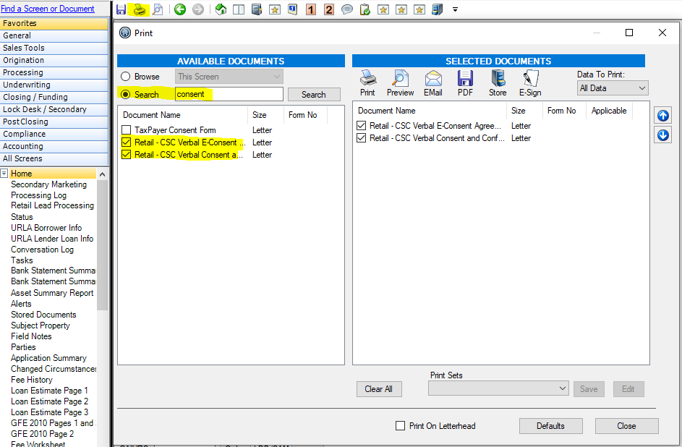
What is Required Continued
2 options to uploading consent forms. Either through Flofy or Verbal Consent forms in BytePro
These items will need to be uploaded into BytePro under the Shared Folder
If going off Verbal Consent the loan officer will need to do the following:
In the home screen of BytePro select the print button
In the popup select the search button and in the open box type “Consent”
Select “Retail-CSC Verbal E-Consent” & “Retail-CSC Verbal Consent and Confirmation”
Once those items are checked select the store icon

Slide 6
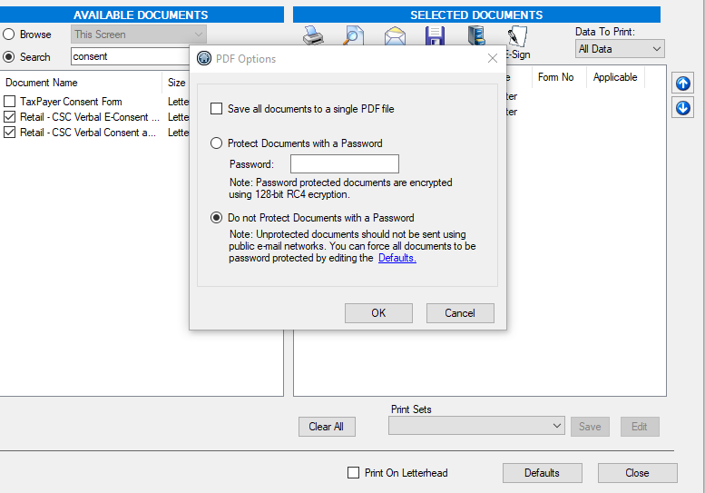
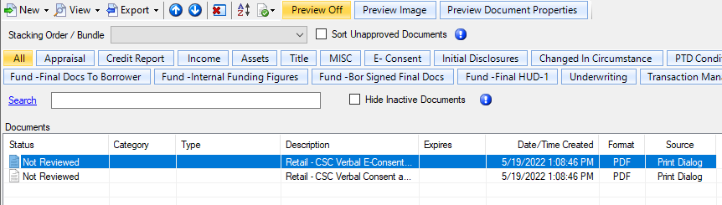
What is Required Continued
Once the “Stored Document” tab is selected the popup shown to the right will appear. Make sure you uncheck “Save all documents to a single PDF file”
Once you select “OK” these items will automatically populate in the Shared Document folder.
Double check they are there, it should look like the image below

Slide 7
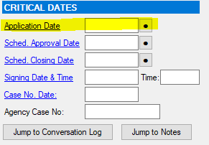
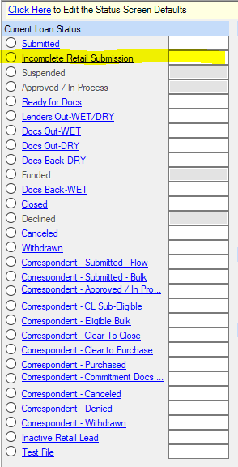
Final Steps for Loan Officer
Once the verbal consent forms or Floify forms are uploaded into BytePro the Loan Officer will update the application date on the Home screen in the Critical Dates Section
In the Status tab the loan officer will then select the “Incomplete Retail Submission” box to create a task for Disclosures to review and do the checks and balance to send out the initial loan disclosures to borrower

Slide 8
Final Steps
Disclosures will get a notification that the file is ready to be disclosed. They will do their due diligence and make sure the Loan Officers NMLS number is updated.
LO’s will create a DV file and upload the Retail Loan Synopsis
Unless stated otherwise Disclosures team will disclose at:
1.5 points for owner occupied
2 points for investment properties
If there is an exception being made, or anything is changing with the cost of the loan, these need to be noted in the con log, examples:
Buying out Prepaids
Buying down the rate or lender credit
Etc.
Disclosures will then email the borrower and CC the loan officer
Once the signed Disclosures are back with the ITP the file will be ready for submission and sent to Beth to assign a Processor

